Slide 1

Exploratory Data Analysis
Real Estate Pricing Analysis
Understanding Price Dynamics in the Housing Market
NEXTHIKE IT SOLUTIONS
VANSHIKA GOEL : DATA SCIENCE INTERN
NextHikes IT Solutions
January 2026

Slide 2
Problem Statement
Identify key variables affecting house prices in real estate market .
Understand patterns, correlations, and trends.
Provide actionable recommendations for pricing strategy.
Enable informed decision-making for property acquisition and sales.
Determine optimal pricing strategies through data analysis.

Slide 3
Data Cleaning
Missing Values: Identified and handled appropriately using imputation or removal
Duplicates: Removed duplicate entries to ensure data integrity
Anomalies: Addressed inconsistencies and outliers in the dataset
Data Validation: Ensured data types and formats are correct
Normalization: Standardized values where necessary for analysis
Result: Clean, reliable dataset ready for comprehensive exploratory analysis

Slide 4
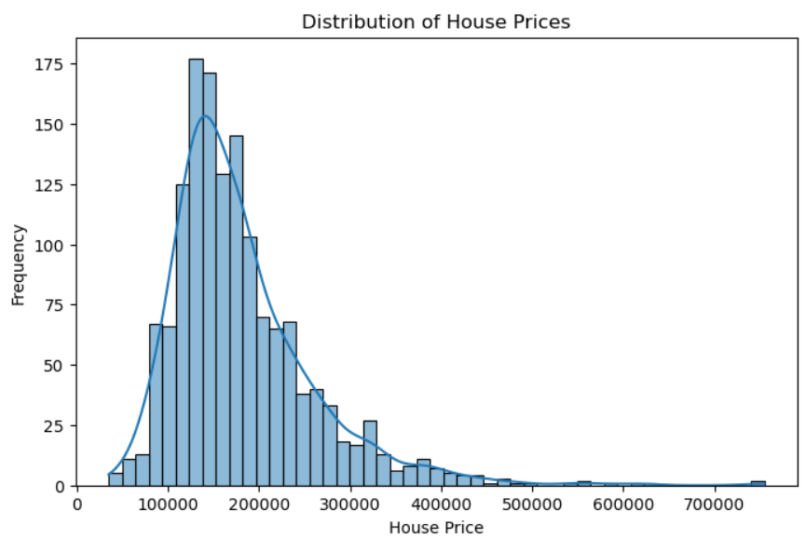
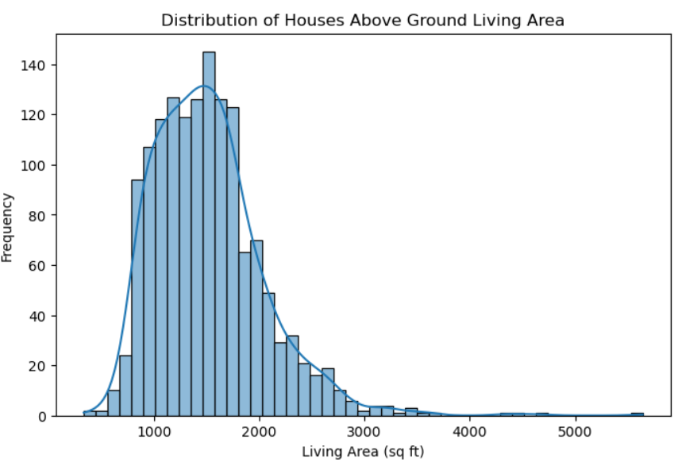
Univariate Analysis
INSIGHTS
INSIGHTS
Majority of properties is affordable to mid-range segment
Outliers represent premium luxury properties.
Distribution is slightly right-skewed.
Most houses have moderate living area.

Slide 5
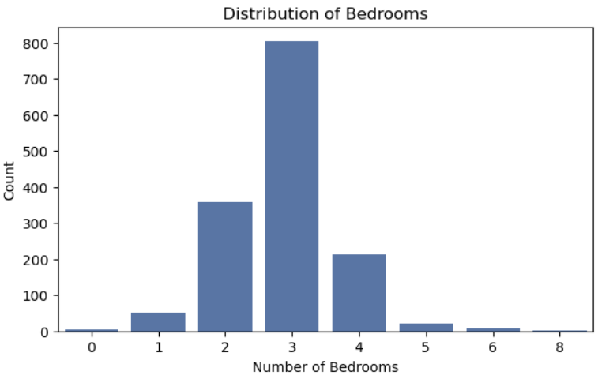
Visualising the houses on the basis of number of bedrooms
Insights
Mostly houses have 2- 4 Bedrooms , indicating standard residential layouts
85 % houses have 2-4 Bedrooms

Slide 6
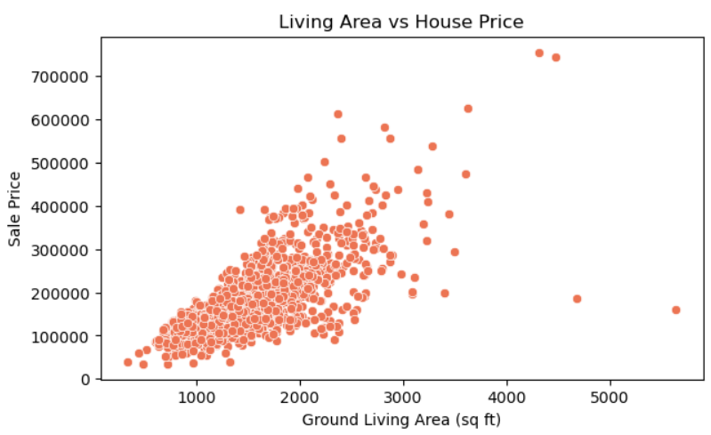
Bivariate Analysis
Analysing relationship between living area and house price.
Insights
Sale price increases as living area increases .
A few large houses have lower prices, indicating outliers.

Slide 7
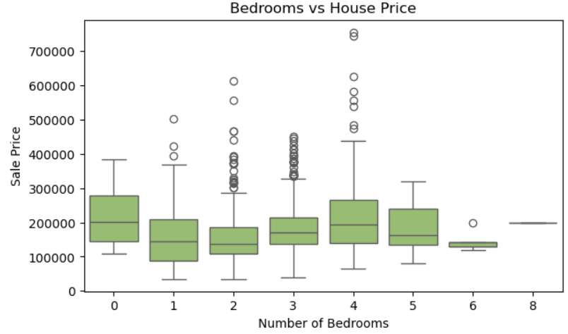
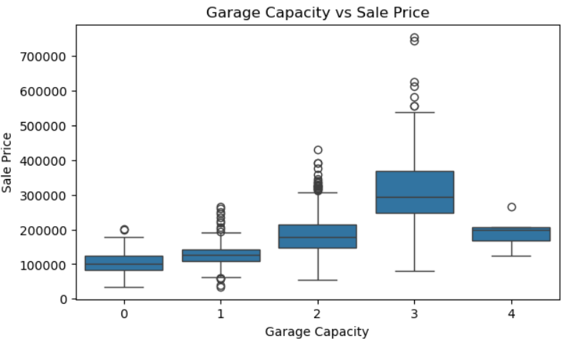
Bedrooms Impact
Garage Influence
Insights
3-4 Bedrooms show the highest and most stable sale prices.
More than 5 bedrooms often lead to unpredictable pricing with wide variation.
Insights
Sale prices increases steadily with garage capacity up to 3 cars .
4-car garages show luxury pricing but with high variability and outliers .

Slide 8
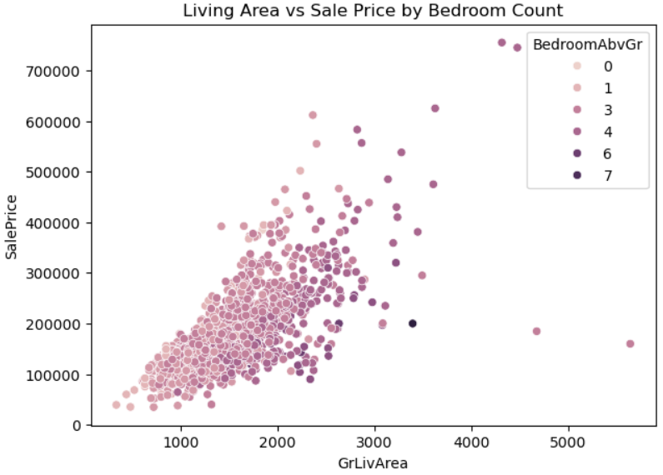
Multivariate Analysis
Insights
Sale prices increases with larger living area across all bedroom counts .
3-4 Bedroom homes dominate mid to high price range , showing strong market preference .

Slide 9
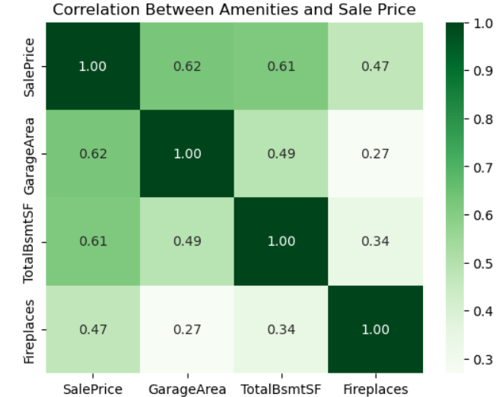
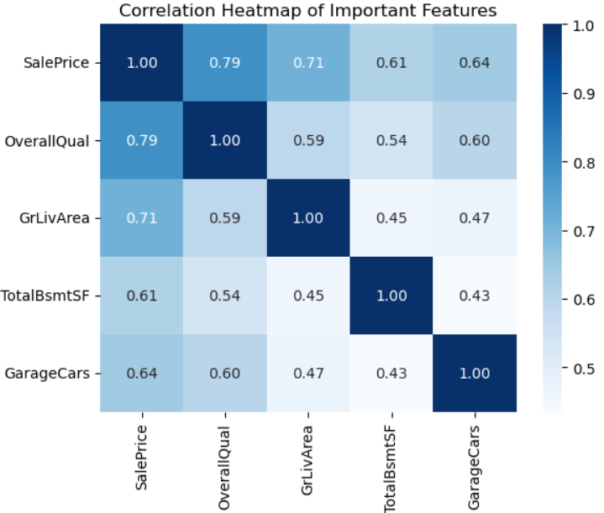
Amenities Correlation
Key Feature Correlation
Insights
Garage area and basement size show strong positive correlation with sale price ( 0.62 and 0.61)
Fireplaces have moderate impact (0.47), suggesting aesthetic features but less than space .
Insights
Overall quality and living area are top predictors .
Garage size and basement area also add strong value .

Slide 10
Key Takeaways
Size is King: Living area strongest predictor
Amenities Matter: Significant price premiums
Market Focus: Mid-range drives opportunity
Garages are valuable — Parking = premium pricing
Combined effect — Features work together to set price

Slide 11
Thank You
NextHikes IT Solutions
January 2026

